Slide 1
Work with hybrid transactional and analytical processing (HTAP) Solutions using Azure Synapse Analytics
Notes:
Before delivering this presentation, review the associated modules on Microsoft Learn (https://aka.ms/mslearn-htap-synapse) and complete the exercises.

Slide 2
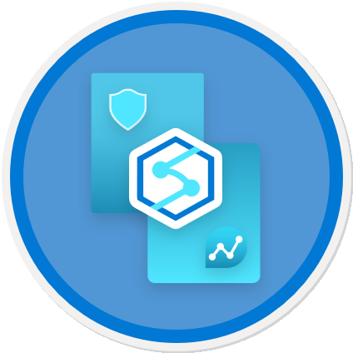
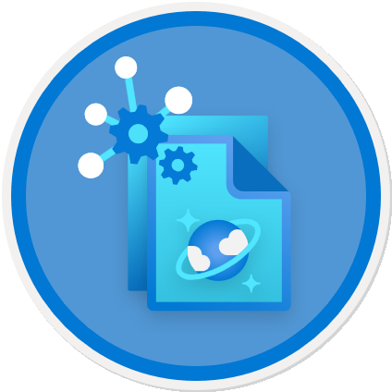
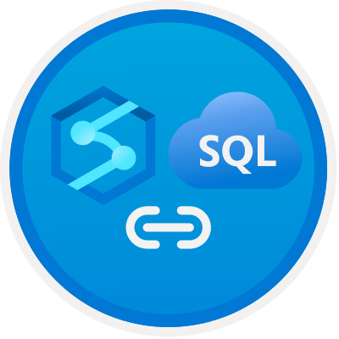
Agenda
Plan hybrid transactional and analytical processing
Implement Azure Synapse Link with Azure Cosmos DB
Implement Azure Synapse Link for SQL

Slide 3
Plan hybrid transactional and analytical processing

Slide 4

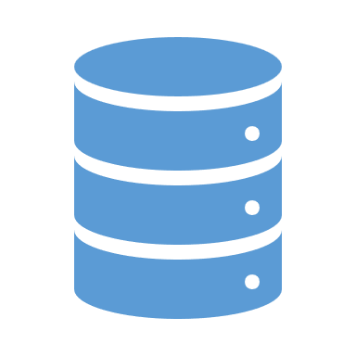
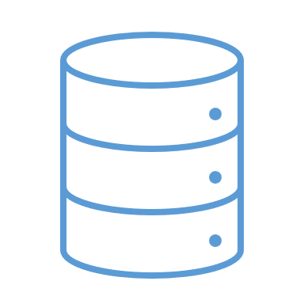
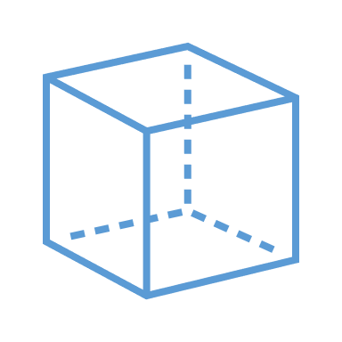






Hybrid transactional and analytical processing patterns
A business application processes user input and stores data in a transactional database that is optimized for a mix of data reads and writes
The application data is automatically replicated to an analytical store with low latency
The analytical store supports data modeling, analytics, and reporting without impacting the transactional system
Notes:
There’s no single definition of HTAP or how it’s implemented; but rather it’s a design pattern in which operational data and analytical data are kept in sync in such a way that enables low-latency analytics without impacting the performance of transactional operations. Different vendors implement HTAP in different ways, and even within Azure Synapse Link (the capability within Azure Synapse Analytics that enables HTAP), the implementation details vary across operational data sources – as we’ll see later in this module.

Slide 5

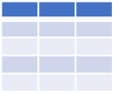
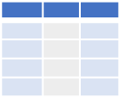





Azure Synapse Link
Azure Cosmos DB
Transactional data stored in Azure Cosmos DB container
Data is synced to an analytical store in the container, and queried via linked service in Azure Synapse Analytics
Azure SQL
Transactional data stored in Azure SQL Database or SQL Server
Transactions are sync’d to a dedicated SQL pool in Azure Synapse Analytics
Microsoft Dataverse
Transactional data stored in Dataverse tables
Data is sync’d to data lake and queries via linked service in Azure Synapse Analytics
Notes:
Azure Synapse Link is the general name for a set of HTAP capabilities in Azure Synapse Analytics that support commonly used operational data sources. The implementation details varies across the sources.
Check with students on which of the operational sources they are familiar with. You can find overviews of each of these sources at the following links:
Cosmos DB: https://learn.microsoft.com/azure/cosmos-db/introduction
Azure SQL: https://learn.microsoft.com/azure/azure-sql/azure-sql-iaas-vs-paas-what-is-overview?view=azuresql
Microsoft Dataverse: https://learn.microsoft.com/power-apps/maker/data-platform/data-platform-intro
In this Azure-focused course, well explore Azure Synapse Link for Azure Cosmos DB and Azure SQL. Students who want to learn more about Azure Synapse Link for Dataverse can refer to the documentation at https://learn.microsoft.com/power-apps/maker/data-platform/export-to-data-lake.

Slide 6

Knowledge check
Which of the following descriptions matches a hybrid transactional/analytical processing (HTAP) architecture?
Applications store data in a transactional data store, which is also used to support analytical queries for reporting
Application transactional data stores are synchronized to a separate analytical store for reporting and analysis
Applications store transactional data in an analytical data store that is optimized for reporting and analysis
You want to use Azure Synapse Analytics to analyze operational data stored in a Cosmos DB for NoSQL container. Which Azure Synapse Link service should you use?
Azure Synapse Link for SQL
Azure Synapse Link for Dataverse
Azure Synapse Link for Azure Cosmos DB
Notes:
Allow students a few minutes to think about the questions, and then use the animated slide to reveal the correct answers.

Slide 7
Implement Azure Synapse Link with Azure Cosmos DB

Slide 8
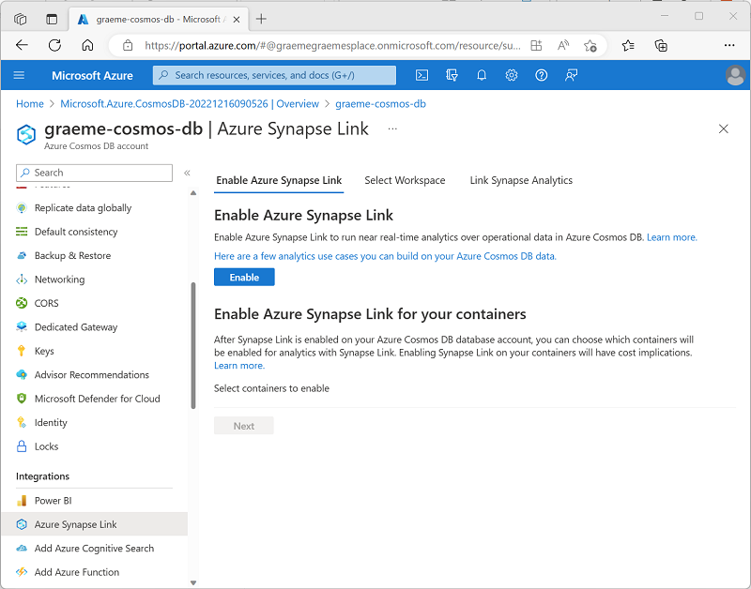
Enable Azure Synapse Link in Azure Cosmos DB
Create an Azure Cosmos DB account that supports Synapse Link:
Azure Cosmos DB for NoSQL
Azure Cosmos DB for MongoDB
Azure Cosmos DB for Apache Gremlin
Enable Azure Synapse Link
Azure portal
Azure PowerShell
Azure CLI
After enabling Azure Synapse Link, you can’t disable it!
Notes:
Azure Cosmos DB is a data service that provides multiple APIs for data storage and queries. There are some differences between the way Azure Synapse Link is managed for each of the APIs, but the general approach is the same. The first step is to enable Azure Synapse Link for your Azure Cosmos DB account.
Note that Azure Cosmos DB is constantly improved. The slide covers the Azure Synapse Link options available at the time of writing.

Slide 9
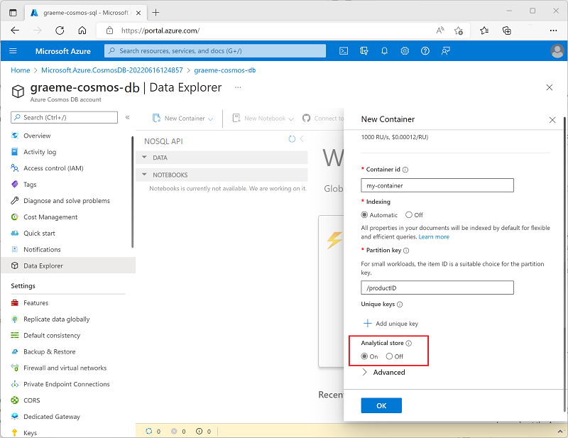
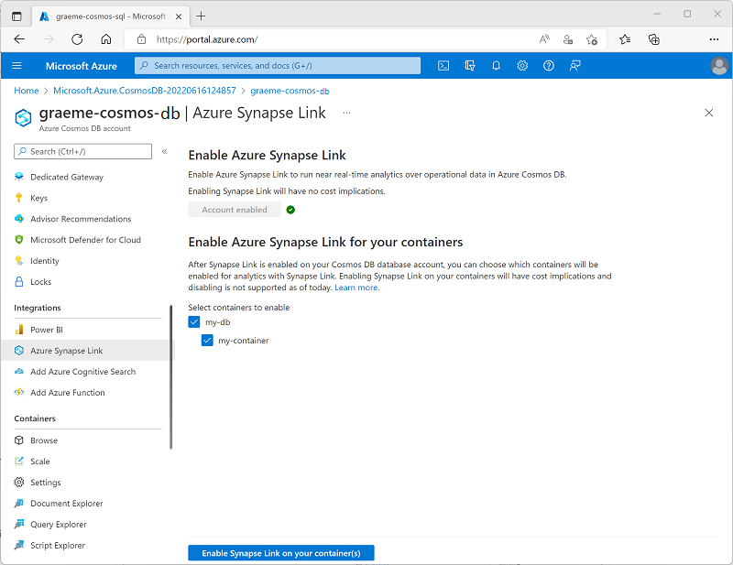
Create an analytical store enabled container
Create a new container with Analytical store enabled
Enable Analytical store in an existing container
Notes:
The slide shows how to enable a container for Azure Synapse link when using the NoSQL API. At the time of writing, you can’t enable Synapse Link for existing MongoDB containers – only new ones. You can enable Synapse Link for existing or new Gremlin graphs.

Slide 10
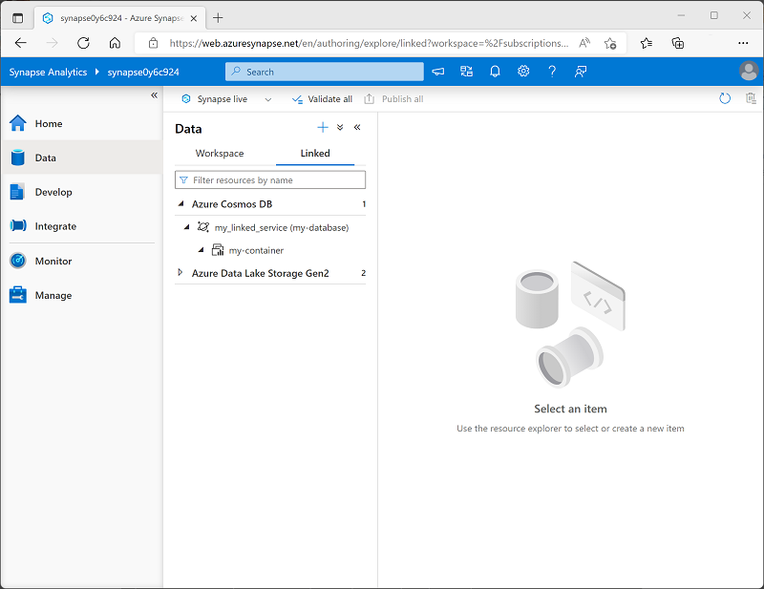
Create a linked service in Azure Synapse Analytics
Create an Azure Cosmos DB linked service with one of the following authentication types:
Account key
Service Principal
System Assigned Managed Identity
User Managed Identity
Notes:
Point out that you can also create a linked service for an Azure Cosmos DB container for which HTAP is not enabled – the icon shown in Azure Synapse Studio is slightly different depending on whether the container is HTAP enabled or not.

Slide 11
Query Cosmos DB
Spark pool
df = spark.read
.format("cosmos.olap")\
.option("spark.synapse.linkedService", "my_linked_service")\
.option("spark.cosmos.container", "my-container")\
.load()
display(df.limit(10))
SQL pool
CREATE CREDENTIAL my_credential
WITH IDENTITY = 'SHARED ACCESS SIGNATURE',
SECRET = 'abcd1234....==';
SELECT *
FROM OPENROWSET(​PROVIDER = 'CosmosDB',
CONNECTION = 'Account=my-cosmos-db;Database=my-db',
OBJECT = 'my-container',
SERVER_CREDENTIAL = 'my_credential'
) AS cosmos_data
Notes:
Use the code samples to underline that you can access Cosmos DB Analytical data using both Spark and SQL. Students will get to try both of these approaches in the lab.

Slide 12

Exercise: Implement Azure Synapse Link for Cosmos DB
Use the hosted lab environment provided, or view the lab instructions at the link below:
https://aka.ms/mslearn-synapse-cosmos
Notes:
The exercise will take a minimum of 35 minutes to complete, including 5-10 minutes at the start to set up the environment.
Not all students work at the same pace, so you should allow 45 minutes or more as necessary for your class.
While students are completing the exercise, you can prepare for the next demonstration by running the setup script for that exercise.

Slide 13
Knowledge check
You have an Azure Cosmos DB for NoSQL account and an Azure Synapse Analytics workspace. What must you do first to enable HTAP integration with Azure Synapse Analytics?
Configure global replication in Azure Cosmos DB
Create a dedicated SQL pool in Azure Synapse Analytics
Enable Azure Synapse Link in Azure Cosmos DB
You have an existing container in a Cosmos DB core (SQL) database. What must you do to enable analytical queries over Azure Synapse Link from Azure Synapse Analytics?
Delete and recreate the container
Enable Analytical Store support in the container
Add an item to the container
You plan to use a Spark pool in Azure Synapse Analytics to query an existing analytical store in Azure Cosmos DB. What must you do?
Create a linked service for the Azure Cosmos DB database where the analytical store enabled container is defined
Disable automatic pausing for the Spark pool in Azure Synapse Analytics
Install the Azure Cosmos DB SDK for Python package in the Spark pool
Notes:
Allow students a few minutes to think about the questions, and then use the animated slide to reveal the correct answers.

Slide 14
Implement Azure Synapse Link for SQL

Slide 15




Azure Synapse Link for SQL
Transactional is data stored in the source database (Azure SQL Database or SQL Server 2022)
Azure SQL Managed Instance is not supported by Azure Synapse Link for SQL
The change feed service captures each transaction and forwards to the target database
Transactions are replayed in the target database (dedicated SQL pool in Azure Synapse Analytics)
Notes:
Note that the architecture for Azure Synapse Link for SQL is different to that of Azure Cosmos DB. The data is replicated to a dedicated SQL pool in the Azure Synapse Analytics workspace by “replaying” transactions that occur in the source database.
The specific implementation details vary between Azure SQL Database and SQL Server, which we’ll discuss next.

Slide 16
Configure Azure Synapse Link for Azure SQL Database
Configure Azure SQL Database:
Select System-assigned managed identity
Set firewall rules
Create an external user and assign db_owner role
Configure the target database
Create a dedicated SQL pool
Create custom schema in the SQL pool database as required
Create a link connection in Azure Synapse Analytics:
Select or create a linked service
Select tables to synchronize
Configure mappings
After initialization, transactions in the source tables are automatically replayed in the target tables
Notes:
Point out that Synapse Link is supported for Azure SQL Database, not Azure SQL Managed Instance.
Note that there are two phases in establishing HTAP with Synapse Link for Azure SQL:
The tables in the target database are initialized by copying the data from the source tables.
Subsequent transactions that change the data in the source tables are “replayed” in the target tables.

Slide 17
Configure Azure Synapse Link for SQL Server 2022
Create landing zone storage
Use a new Azure Data Lake Store Gen2 container
You can’t use the default data lake store for your Azure Synapse Analytics workspace
Configure SQL Server
Create a master key in the source database
Configure the target database
Create a dedicated SQL pool
Create a master key in the SQL pool database
Create a link connection in Azure Synapse Analytics:
Create linked services for SQL Server and the landing zone storage account
Select tables to synchronize
Specify file paths in the landing zone
Table are initialized by copying and bulk loading Parquet files
Updates are applied by copying and ingesting CSV files
Notes:
The implementation of Azure Synapse Link for SQL Server is a little different than for Azure SQL. The initial data and subsequent updates are synchronized to an Azure Data Lake Storage Gen 2 container before being loaded into the dedicated SQL pool database.
If the source SQL Server is on-premises or behind a firewall, you need to set up a self-hosted integration runtime in the network where the SQL Server instance is installed in order to enable the Synapse Link process to successfully connect. See https://learn.microsoft.com/azure/data-factory/create-self-hosted-integration-runtime?tabs=synapse-analytics for details.

Slide 18

Demo: Implement Azure Synapse Link for SQL
You can try this for yourself later by following the instructions at the link below:
https://aka.ms/mslearn-synapse-link-sql
Notes:
The demonstration will take around 35 minutes.
Tell students that they can try the steps for themselves after class, though they may need to use their own Azure subscription if a hosted environment is not provided.

Slide 19
Knowledge check
From which of the following data sources can you use Azure Synapse Link for SQL to replicate data to Azure Synapse Analytics?
Azure Cosmos DB
SQL Server 2022
Azure SQL Managed Instance
What must you create in your Azure Synapse Analytics workspace as a target database for Azure Synapse Link for Azure SQL Database?
A serverless SQL pool
An Apache Spark pool
A dedicated SQL pool
You plan to use Azure Synapse Link for SQL to replicate tables from SQL Server 2022 to Azure Synapse Analytics. What additional Azure resource must you create?
An Azure Storage account with an Azure Data Lake Storage Gen2 container
An Azure Key Vault containing the SQL Server admin password
An Azure Application Insights resource
Notes:
Allow students a few minutes to think about the questions, and then use the animated slide to reveal the correct answers.

Slide 20

Further reading
Work with Hybrid Transactional and Analytical Processing Solutions using Azure Synapse Analytics
https://aka.ms/mslearn-htap-synapse
Notes:
Encourage students to review the online material on Microsoft Learn on which this presentation is based.

